Slide 1
Designing Secure Cloud Applications
ENPM665
Kevin shivers

Slide 2
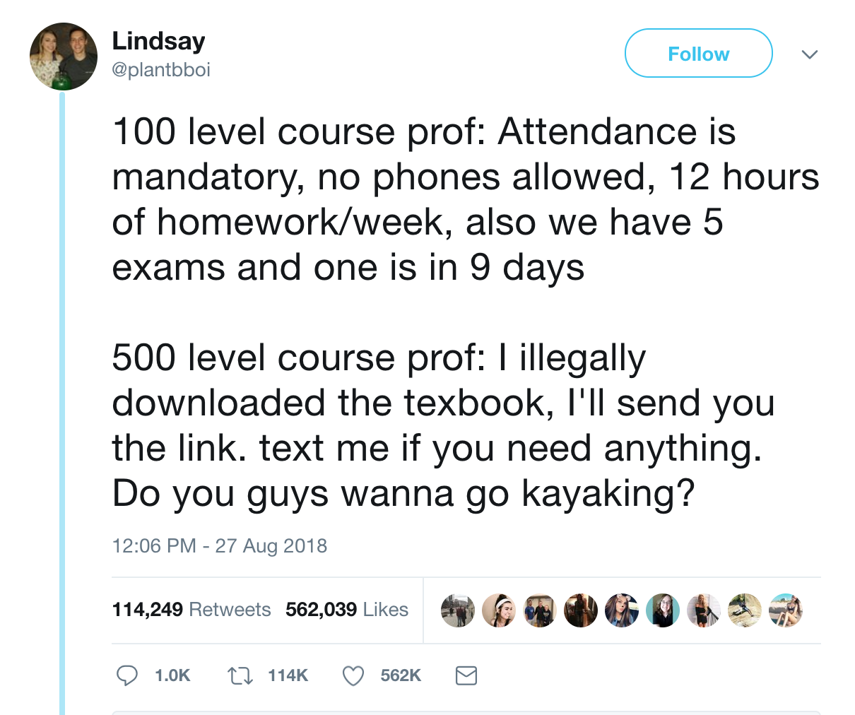
Soooo who wants to go kayaking?
https://twitter.com/plantbboi/status/1034109916825485313

Slide 3
Future Cloud Migrations Incoming?
Broadcom to milk VMware dry? Analysts see trouble in $61B deal - https://www.fierceelectronics.com/sensors/broadcom-milk-vmware-dry-analysts-see-trouble-61b-deal
“…thinking is that Broadcom CEO Hock Tan’s previous pattern of buying up software companies like CA Technologies and Symantec will repeat itself with the VMware purchase, with a heavy-handed focus on producing profits favored by investors that could include cutting operating expenses and research dollars and raising prices on customers.”

Slide 4
Future Cloud Migrations Incoming?
CIOs despise being dependent on specific technologies and eye large licensing expenditures for reductions.
Will this break some organizations from their VWware dependance and move to IaaS and/or containers?

Slide 5
Note
Most of what we’ll talk about today is not limited to cloud security, most are best practices (that often aren’t followed) so since people are moving to the cloud and updating their processes it’s a great time to get security shoved in there.
Also note: I am not a developer.

Slide 6
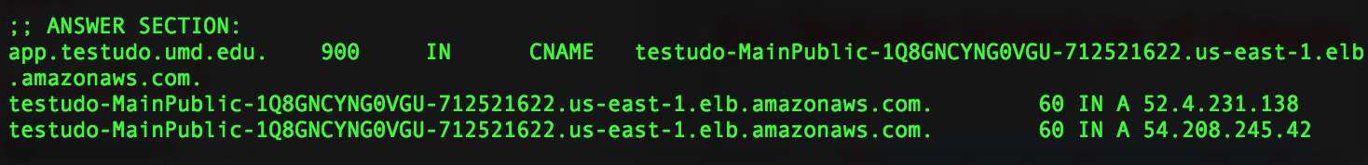
Should it go to the cloud?
Handles low risk data?
Needs to be highly available?
Ex: Testudo Schedule of Classes
https://app.testudo.umd.edu/soc/

Slide 7
Should it go to the cloud?
High value data?
Needs to access internal on-prem resources? (like a mainframe)
Probably not.
Ex: Add/Drop of Testudo backend (on-prem)

Slide 8
Should it go to the cloud?
High value data?
Don’t have the internal resources to monitor systems/keep systems up 24x7/mitigate DDoS?
Maybe the cloud is the better way to go…
Ex. many customer-facing banking websites, ELMS, etc.

Slide 9
Types of cloud migrations
Lift-and-shift
Re-architected

Slide 10

Lift-and-Shift
Minimal code changes
Produces similar risks as on-prem by replicating (moving) vulnerabilities from on-prem into the cloud
Calls for traditional security posture focusing on OS and network level security

Slide 11
Lift-and-Shift
These types of migrations are typically for very small applications or if the app is already “cloud ready”
These type of migrations often fail because of major ties to legacy systems causing major rework and issues.
Lots of ramp up to know how to make an app cloud-ready (and secure!)

Slide 12

Re-architected
Typically with ephemeral hosts (often serverless or container-based) which challenges the typical security concepts of blocking by IP address
Requires an emphasis on programmatic visibility (Visibility-as-a-Service?) and business/application logic security

Slide 13
Common Cloud App Migration Pitfalls
On-prem apps often don’t transfer
Ties to legacy systems
Latency for on-prem -> cloud access
Latency for cloud -> on-prem access
App -> DB connectivity can be a fickle monster
Code just doesn’t run “in the cloud”

Slide 14
Common Cloud App Migration Pitfalls
Not everything is “cloud ready”
While cloud has advantages (otherwise why would it be used?) you often need to redevelop apps to maximize performance, scalability, and add in new features like encryption at rest/in transit

Slide 15
Common Cloud App Migration Pitfalls
Increased risk of ”data bleed”
Not as much of an issue when you run/control the hardware, OS, software, etc.
A (potential) big issue when you’re sharing systems with anyone with a credit card
Bleed between tenants, instances, apps, OS, users

Slide 16
Common Cloud App Migration Pitfalls
Need to use validated and approved APIs
Everyone has an API. Has a process been formalized to vet, select, and deploy only APIs you trust?

Slide 17

Common Cloud App Migration Pitfalls
Poor documentation
Everyone documents as they develop/build/deploy right?

Slide 18
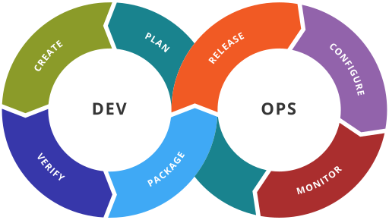
DevOps
Merging of software development and software operations, in the cloud world often integrating systems/network operations as well (infrastructure as code!)

Slide 19
DevOps
Plan - requirements, business/release metrics
Create - code development
Verify - continuous testing tools that provide feedback on business risks
Package — approval, package config, application pre-deployment staging
Release — change management, release approvals, release automation
Configure — infrastructure configuration and management, Infrastructure as Code tools
Monitor — applications performance monitoring, end–user experience

Slide 20
Injecting security in DevOps process
1. Plan – Security policy and requirements
2. Create – Secure coding best practices
3. Verify – Code review, vulnerability scanning, static/dynamic analysis
6. Configure —Infrastructure as Code security best practices
7. Monitor — monitoring logs (system, DB, app, etc for security issues)

Slide 21
DevOps tends to fail open
Developers often “just want to make it work”
This often means allow 0.0.0.0/0, no patch mgmt solution, and fairly open API access
“I’ll come back and fix this later…”
That’s usually bad from a security standpoint

Slide 22
Who’s steering the ship?
If the dev team is driving the cloud adoption then they are probably setting the firewall rules and configuring the API access policies.
*See “This often means allow 0.0.0.0/0 and fairly open API access” from previous slide

Slide 23
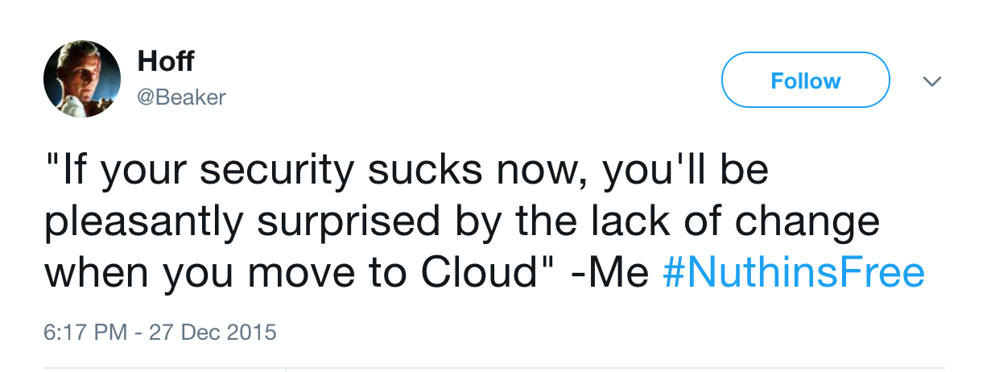
https://twitter.com/beaker/status/681252570707394561

Slide 24
DevSecOps
Adding security into the DevOps process
Everyone is responsible for security!

Slide 25
DevSecOps
Security is often seen as a roadblock for development, especially in the DevOps world.
We don’t want to be ignored or bypassed so let’s integrate into the process from the start holistically.

Slide 26
DevSecOps Principles
Standardize and automate the environment
Each service uses principle of least privilege to minimize unauthorized connections and access.
No one-offs to forget about!

Slide 27
DevSecOps Principles
Strong centralized identity and access management
Users, developments, admins only have the access they need
Account lifecycle process is well defined and followed

Slide 28
DevSecOps Principles
Isolated systems/containers running microservices
Each system/container does their part and just their part
Segmented and encrypted from each other – a breach of one container does not compromise the whole system

Slide 29
DevSecOps Principles
Encrypt all the things!
Encrypt data in transit and at rest
Encrypt the data while processing?

Slide 30
DevSecOps Principles
Secure API gateways
Reduce exposure
Increase log visibility and authentication

Slide 31
DevSecOps Principles
Integrate and automate security scanning from the start
Code analysis
Scan hosts/containers

Slide 32
DevSecOps Principles
Automated testing and test results are part of acceptance testing

Slide 33
DevSecOps Principles
Automate security updates
Automation tools for patching OS, core services (Apache, etc.) and the application itself
Log, review, and verify

Slide 34
DevSecOps Principles
Automate system/service configuration management
Automates and verifies compliance with security policies
Eliminates manual “fixes” and errors

Slide 35
Identity and Access Management
(We’ll talk more about this soon)
Single Sign On/Federated Identity Management = app doesn’t need focus on identification and authentication, SSO/FIM does that
The app just needs to focus on authorization

Slide 36
Authentication vs Authorization?
What’s the difference?

Slide 37
Cloud Insecurity?
Out-of-band management – Cloud API’s operate outside of traditional security controls, can make all existing controls irrelevant
(Remember this from last week?)

Slide 38
Resilient Systems
If a system goes offline because of a denial of service attack or a hardware failure is that an operation issue or a security issue?
What’s the ”A” in the CIA triad?

Slide 39
What’s the ”A” in the CIA triad?
Availability

Slide 40
Can your app scale to survive a DDoS?
AWS Best Practices: https://d1.awsstatic.com/whitepapers/Security/DDoS_White_Paper.pdf
Azure Best Practices: https://docs.microsoft.com/en-us/azure/security/azure-ddos-best-practices
Google Cloud Best Practices: https://cloud.google.com/files/GCPDDoSprotection-04122016.pdf

Slide 41
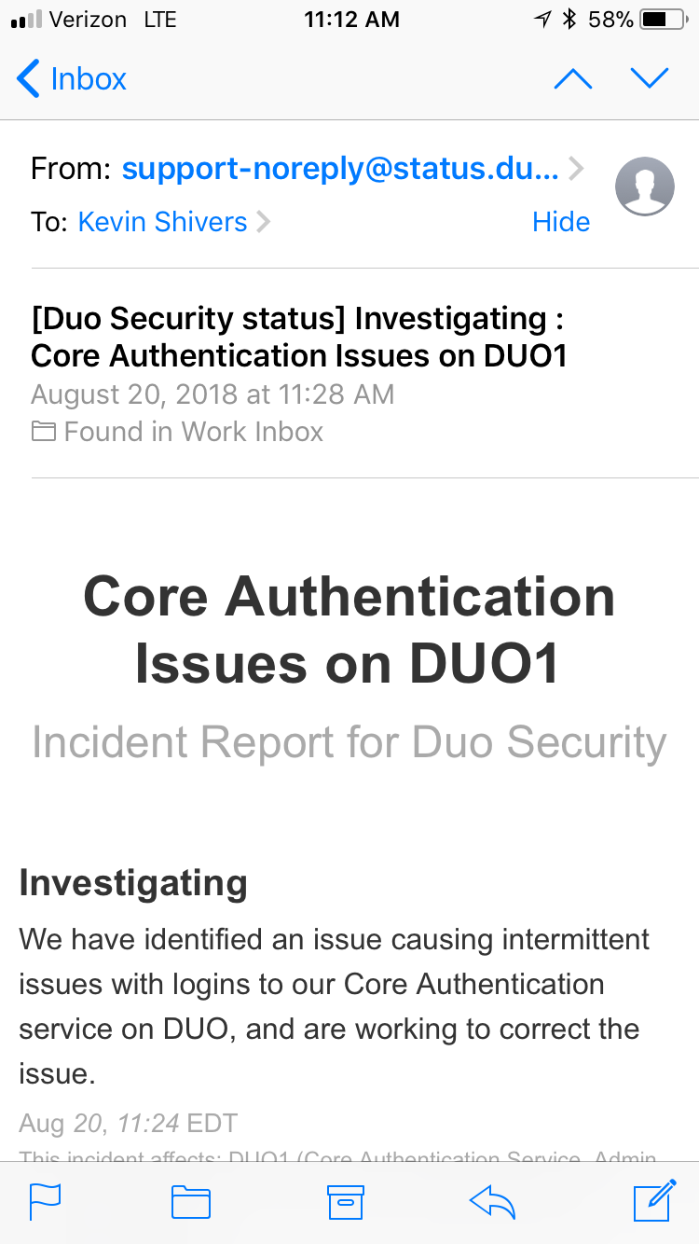
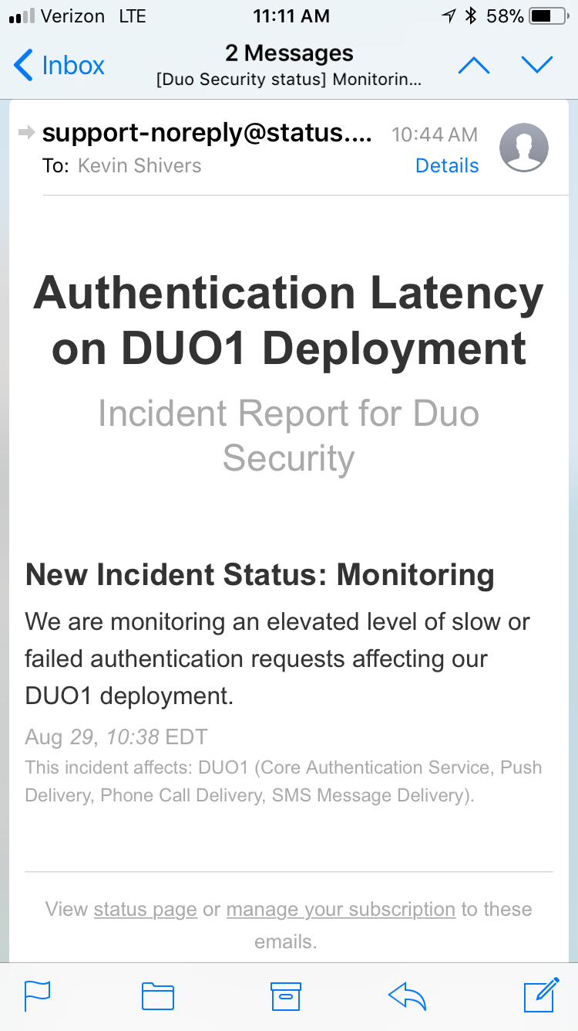

Slide 42
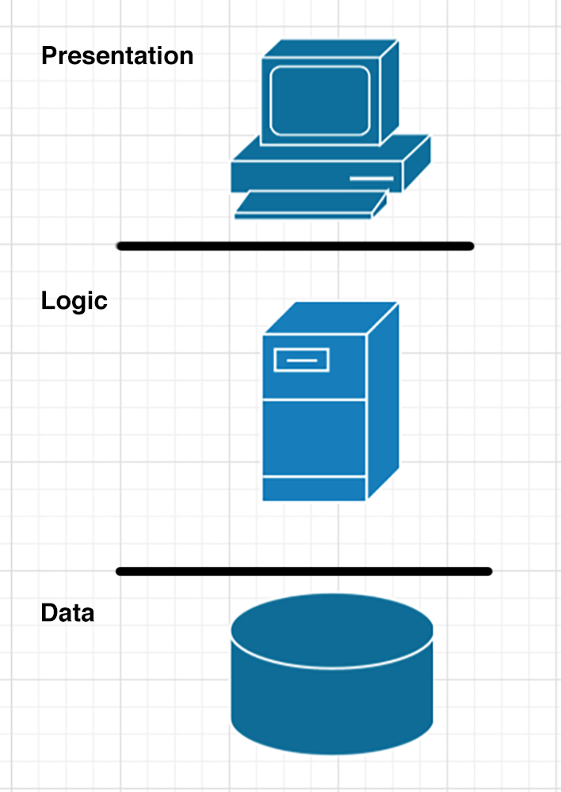
Standard 3 Tier

Slide 43
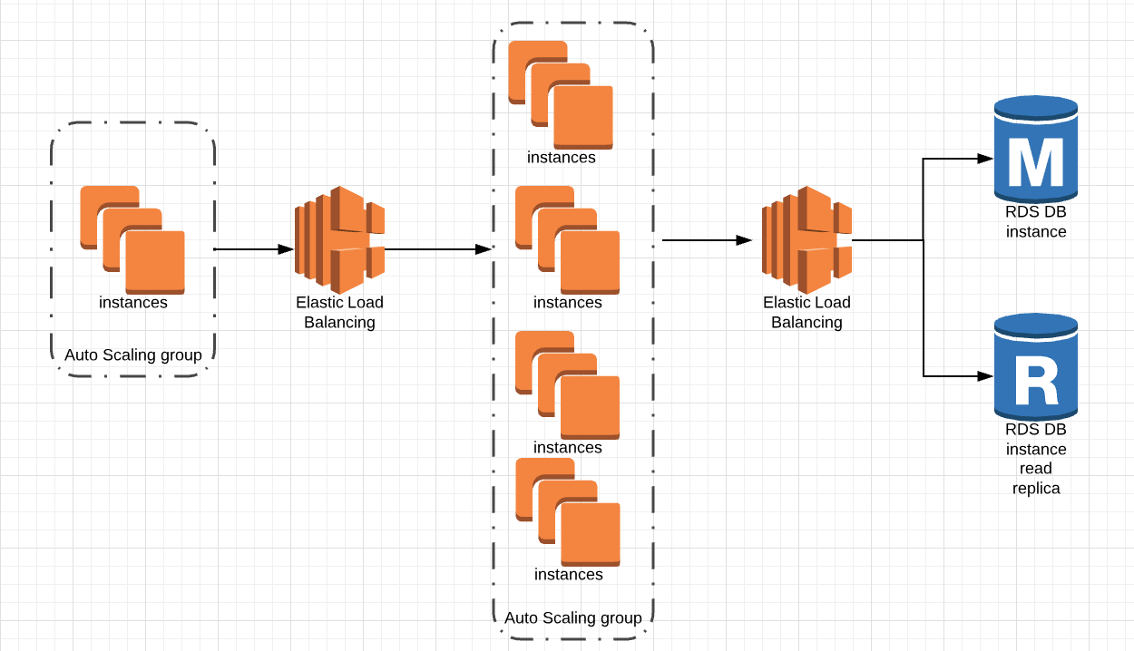
Sample Rearchitected 3 Tier

Slide 44
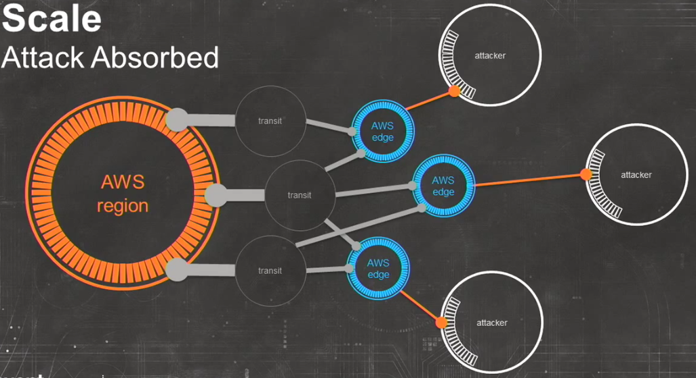
https://privatedock.wordpress.com/2013/12/28/ddos-resiliency-with-aws/

Slide 45
Back to basics
Other secure app design principles as something moves to the cloud

Slide 46
Secure Code Reviews
Use both automated tools and manual review
Review code every time there is a meaningful change
Checklists are your friend
Don’t play the blame game
Possible teaching moment

Slide 47
Threat modeling - STRIDE
Spoofing of user identity
Tampering
Repudiation
Information disclosure
Denial of service
Elevation of privilege

Slide 48
Common Vulnerabilities
Injection (SQL, command, LDAP)
Broken Authentication
Cross Site Scripting (XSS)
Cross Site Request Forgery (CSRF)
Insure Direct Object Access

Slide 49
Common Vulnerabilities
Misconfigurations
Sensitive Data Exposure
Missing Function-level Access Control
Invalidated Redirects and Forwards
Using Components with Known Vulnerabilities

Slide 50
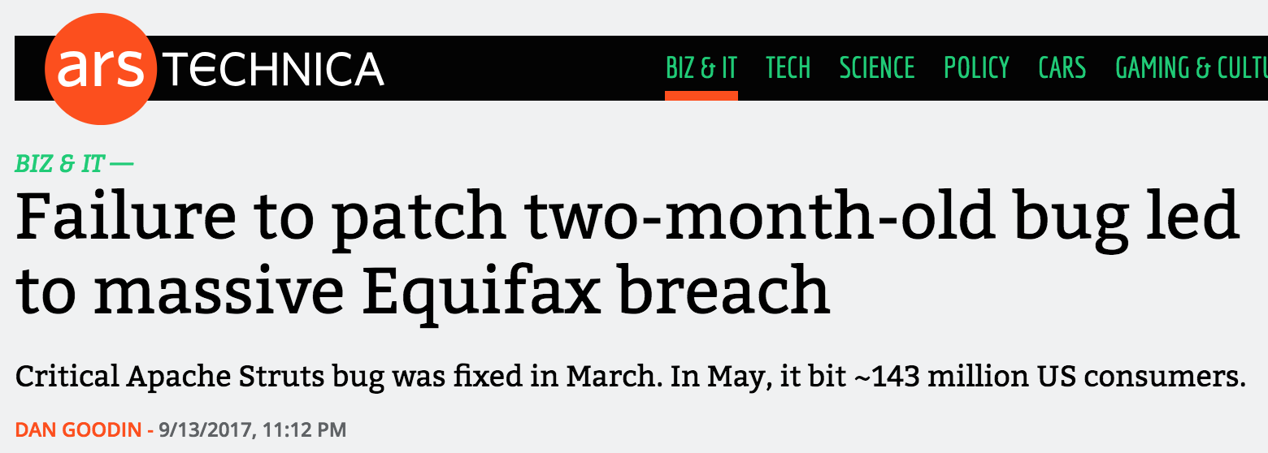
Using Components with Known Vulnerabilities
https://arstechnica.com/information-technology/2017/09/massive-equifax-breach-caused-by-failure-to-patch-two-month-old-bug/

Slide 51
OWASP Top 9 Coding Flaws
https://www.owasp.org/index.php/The_Owasp_Code_Review_Top_9
Input validation
Source code design
Information leakage and improper error handling
Direct object reference

Slide 52
OWASP Top 9 Coding Flaws
Resource usage
API usage
Best practices violation
Weak Session Management
Using HTTP GET query strings

Slide 53
CSA Treacherous 12
https://downloads.cloudsecurityalliance.org/assets/research/top-threats/Treacherous-12_Cloud-Computing_Top-Threats.pdf

Slide 54
CSA Treacherous 12
Data Breaches – Breach of cloud data
Insufficient Identity, Credential and Access Management
Insecure Interfaces and APIs
System Vulnerabilities
Account Hijacking
Malicious Insiders

Slide 55
CSA Treacherous 12
Advanced Persistent Threats
Data Loss
Insufficient Due Diligence
Abuse and Nefarious Use of Cloud Services
Denial of Service
Shared Technology Vulnerabilities

Slide 56
1. Data Breaches
“In mid-2015, BitDefender, an antivirus firm, had an undisclosed number of customer usernames and passwords stolen due to a security vulnerability in its public cloud application hosted on AWS. The hacker responsible demanded a ransom of $15,000.”

Slide 57
2. Insufficient Identity, Credential and Access Management
Leaked API keys = cryptomining
Attackers Scrape GitHub for Cloud Service Credentials, Hijack Account to Mine Virtual Currency – “Cloud service provider credentials included in a GitHub project were discovered and misused within 36 hours of the project going live.”

Slide 58
3. Insecure Interfaces and APIs
“In mid-2015, the US Internal Revenue Service (IRS) exposed over 300,000 records via a vulnerable API (Get Transcript)”

Slide 59
4. System Vulnerabilities
Magnified Losses, Amplified Need for Cyber-Attack Preparedness – “Heartbleed and Shellshock proved that even open source applications, which were believed more secure than their commercial counterparts ... , were vulnerable to threats. They particularly affected systems running Linux, which is concerning given that 67.7% of websites use UNIX, on which the former (Linux) is based.”

Slide 60
5. Account Hijacking
In April 2010, Amazon experienced a cross-site scripting (XSS) bug that allowed attackers to hijack credentials from the site. In 2009, numerous Amazon systems were hijacked to run Zeus botnet nodes.
In June 2014, Code Spaces’ Amazon AWS account was compromised when it failed to protect the administrative console with multifactor authentication. All the company’s assets were destroyed, putting it out of business.

Slide 61
6. Malicious Insiders
Insider Threats to Cloud Computing – “Overall, the ‘inside job’ is responsible for most cloud computing security woes. Enterprises have to become proactive in finding solutions to their security threats to protect their sensitive information.”

Slide 62
7. Advanced Persistent Threats
Current Trends in the APT World – “The alleged Chinese Cyber-Espionage with its APTs caused the theft of “ ‘hundreds of terabytes of data from at least 141 organizations across a diverse set of industries beginning as early as 2006.’ ”

Slide 63
8. Data Loss
In April 2011, Amazon EC2 suffered a crash that led to significant data loss for many customers.
See also Code Spaces example

Slide 64
9. Insufficient Due Diligence
Contract and Financial Viability – In 2013, Nirvanix, a cloud storage specialist that hosted data for IBM, Dell and its own customers, led for Chapter 11 bankruptcy and shuttered its operations. Customers were given less than two weeks to move their data to another service, which highlighted the following issues:
Data Loss
Operation disruptions
Security breaches
Non-compliance

Slide 65
10. Abuse and Nefarious Use of Cloud Services
Hackers Sneak Back Into AWS for DDoS Launch Hub – “Amazon’s Elastic Cloud Computing division was suffering from a highly sophisticated attack by a group of unknown hackers, who had found a way to reverse engineer proof-of-concept code and create an easily-accessible backdoor for themselves into Amazon’s massive bank of available processing power.”

Slide 66
11. Denial of Service
See Mirai botnet DDoS attack against KrebsOnSecurity, Dyn, etc

Slide 67
12. Shared Technology Vulnerabilities
See Spectre, Meltdown, Venom, etc.

Slide 68
Do your core providers scale?
Who’s running your DNS?
Who’s running your data pipes? Who’s running your customer’s data pipes?

Slide 69
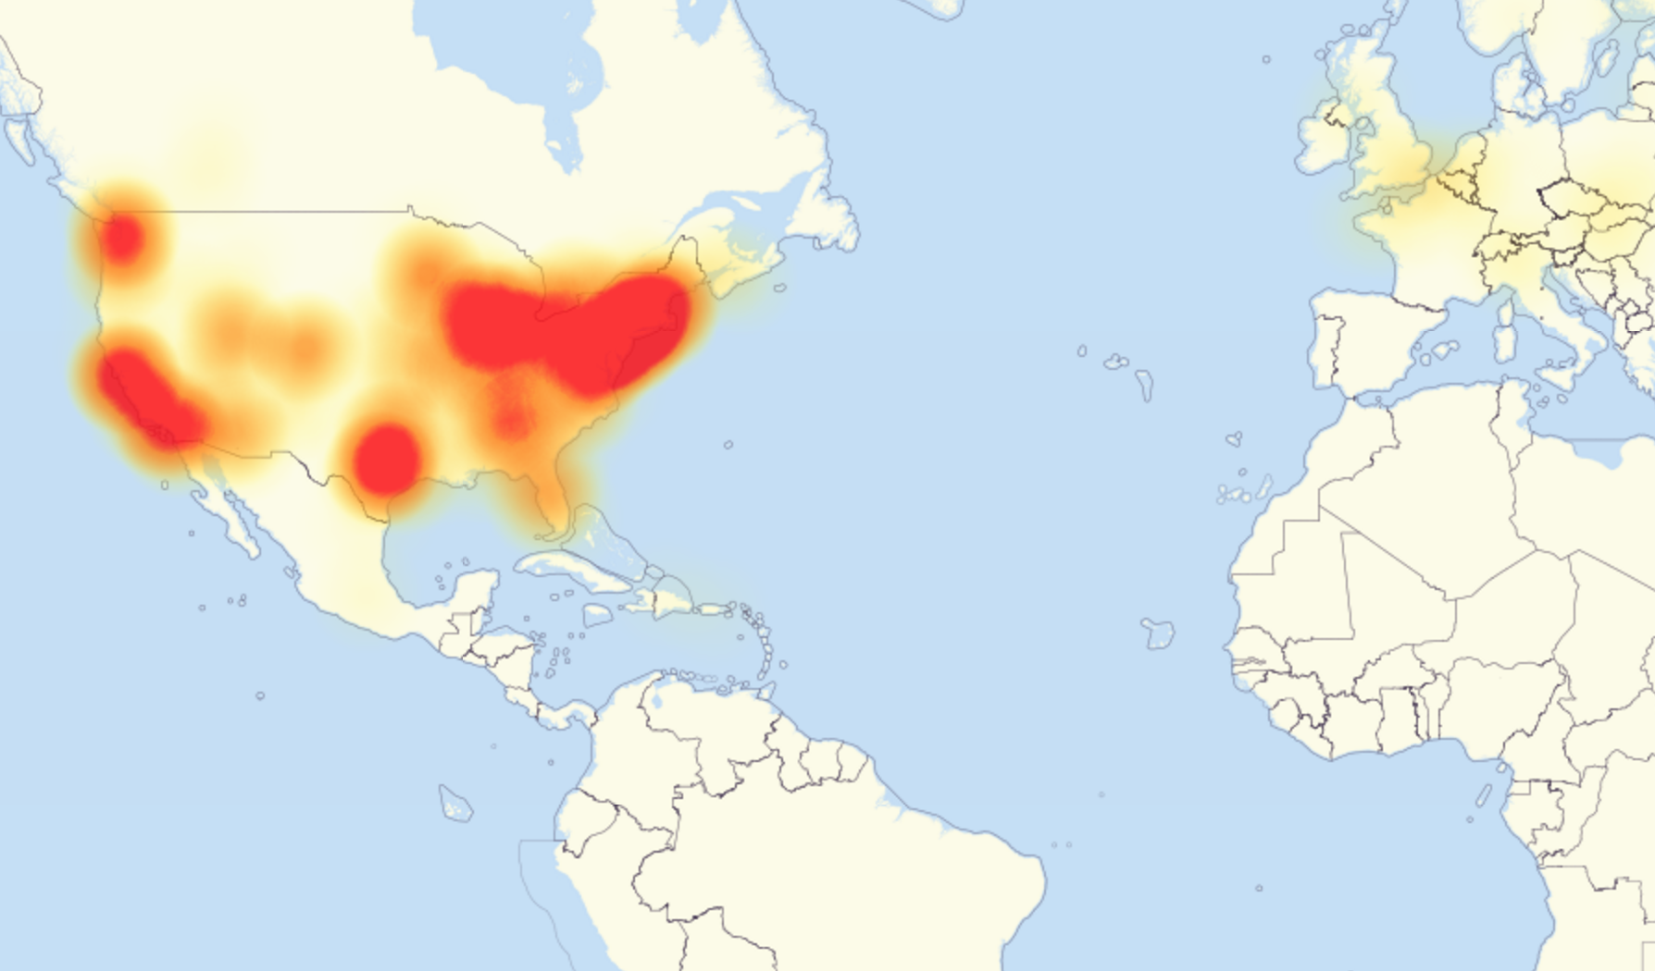
Mirai DDoS against Dyn
https://dyn.com/blog/dyn-statement-on-10212016-ddos-attack/

Slide 70
Comcast outage
“Comcast and Xfinity suffered the biggest service interruptions across its internet, cable, and landline products. The company, which has more than 29 million business and individual customers, said on Friday that the outages stemmed from fiber optic cables at two internet infrastructure companies that were cut or otherwise disrupted.”
https://www.wired.com/story/friday-comcast-outage-cut-fiber/

Slide 71
Encrypt all the things!
Data at rest (whole disk/instance, volume)
Data in transit (TLS/SSL, VPNs)
Data while in use? (Homomorphic encryption*)
* = CCSP/CISSP buzzword!

Slide 72
Don’t Put All Your Eggs In One Basket
Splitting cloud workloads into many accounts = good
Limit blast radius
Single account should not contain 100% of a workload
Doable for API-based apps, really hard for “lift and shift” apps

Slide 73
Sandboxing
A protected area used for testing untested or untrusted code or data.
Can use this to test that the application is working as expected or to limit blast radius

Slide 74
Case Study: HR resume review
”My use case is examining, cleaning and possibly distributing application letters and CVs. If you have to read job application letters, the advice to just open files from people you trust, just doesn’t work. The amount of untargeted malware we receive through this channel is considerable. We had targeted attacks too.
I’ve known about Qubes OS for a long time but interestingly the advice to use it for all processing of application letters didn’t come from my tech circles but from a recruiter.”
https://news.ycombinator.com/item?id=16255251

Slide 75
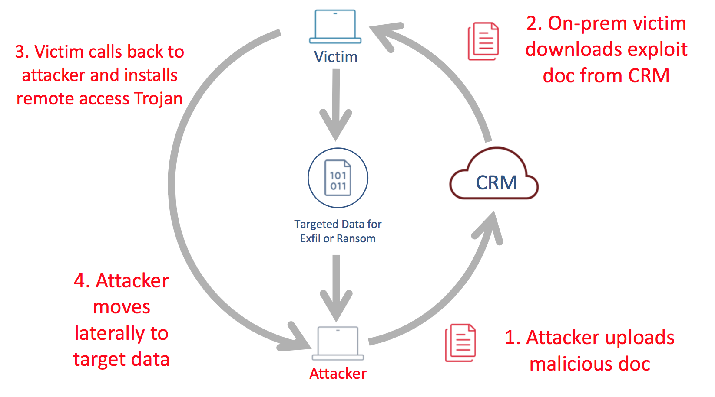
Case Study: HR resume review

Slide 76
MFA all the things!
Passwords aren’t enough
Especially when it comes to important infrastructure
Use MFA to protect Console UI accounts and API creds used by humans (where possible)

Slide 77
Additional Security Technology
Firewalls
Web Application Firewall
Database Firewall (Database Activity Monitoring)

Slide 78
Firewalls and Intrusion Detection
Host-based or Network-based
In the cloud typically host-based as network-based severely limits cloud flexibility

Slide 79
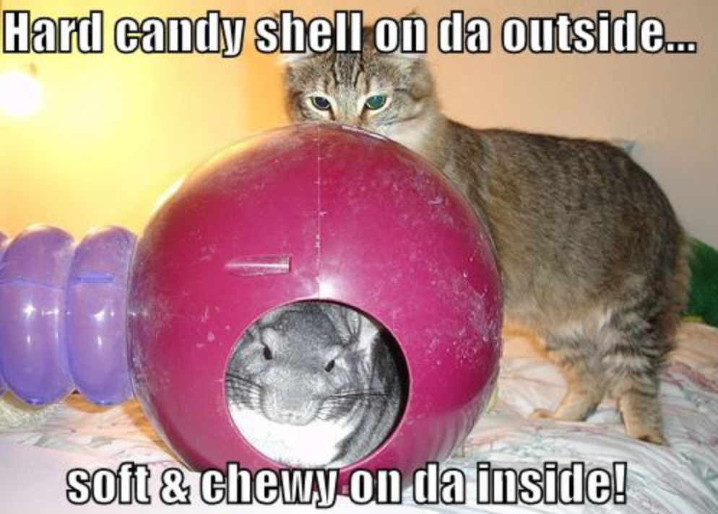
Old School
“Hard shell and a soft, chewy inside”

Slide 80
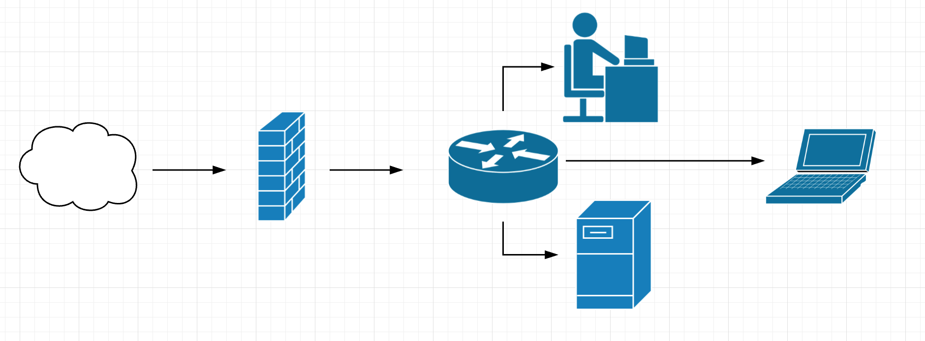
Old School

Slide 81
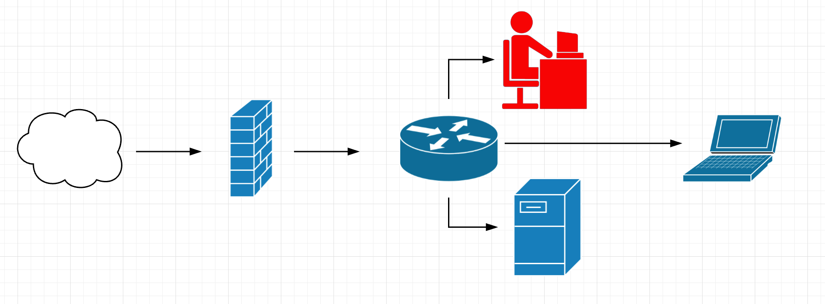
Old School

Slide 82
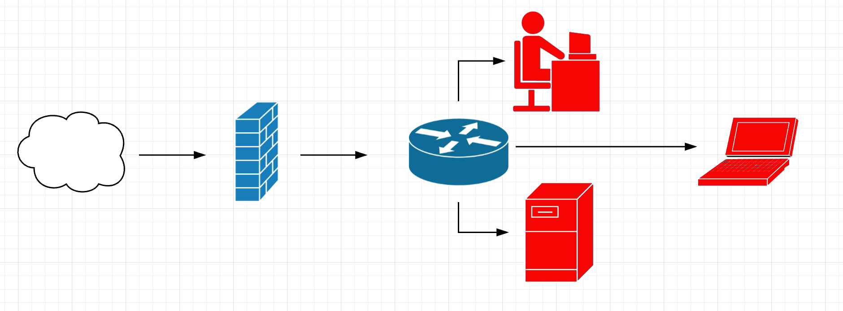
Old School

Slide 83
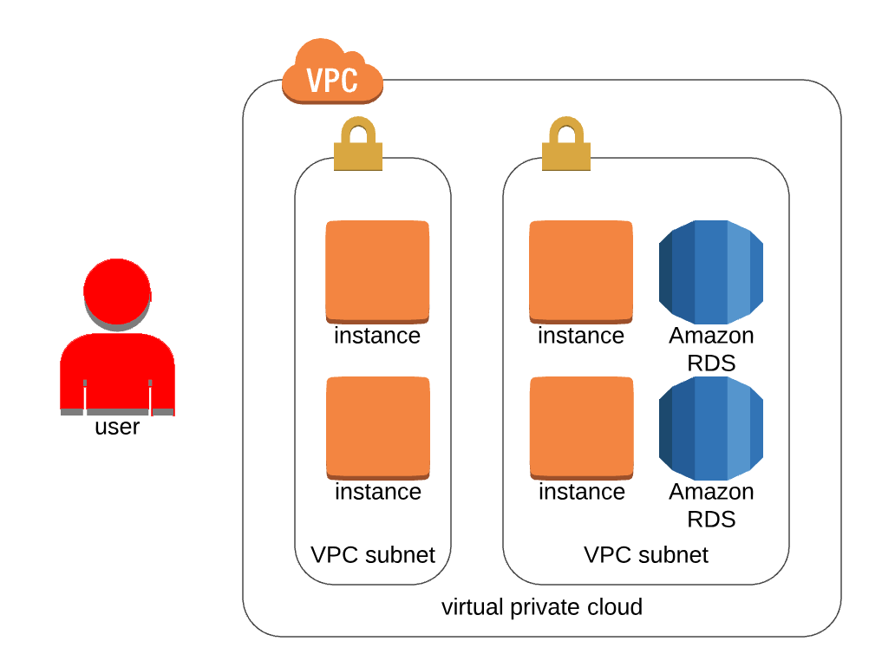
New School - AWS

Slide 84
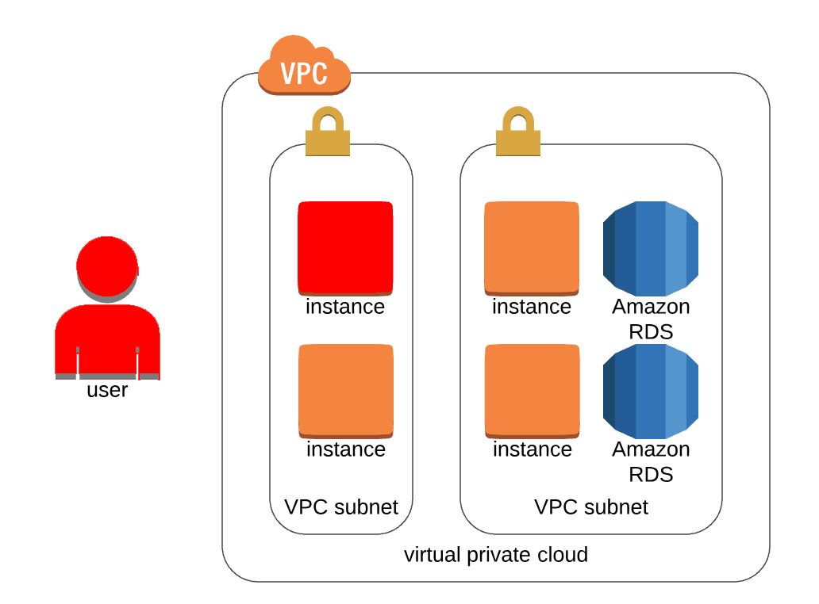
New School - AWS

Slide 85
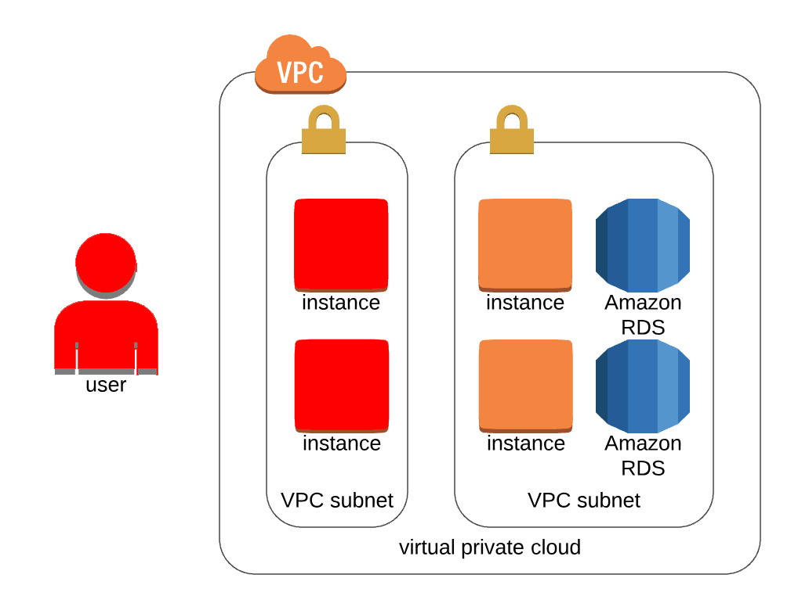
New School – AWS

Slide 86
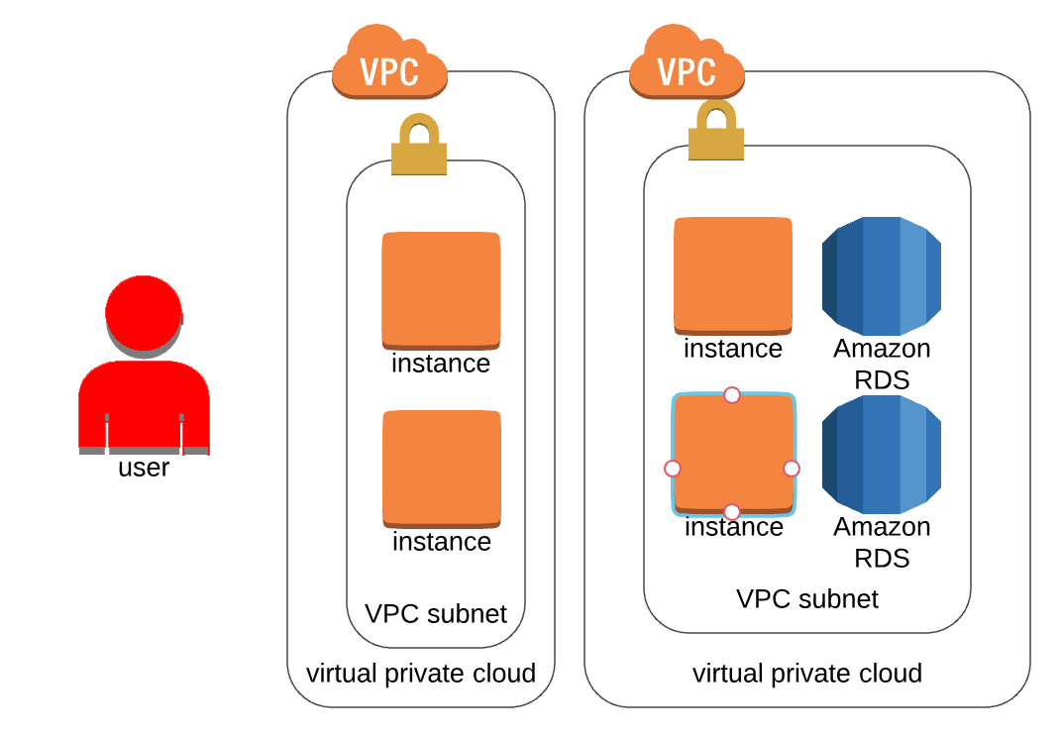
New School - AWS

Slide 87
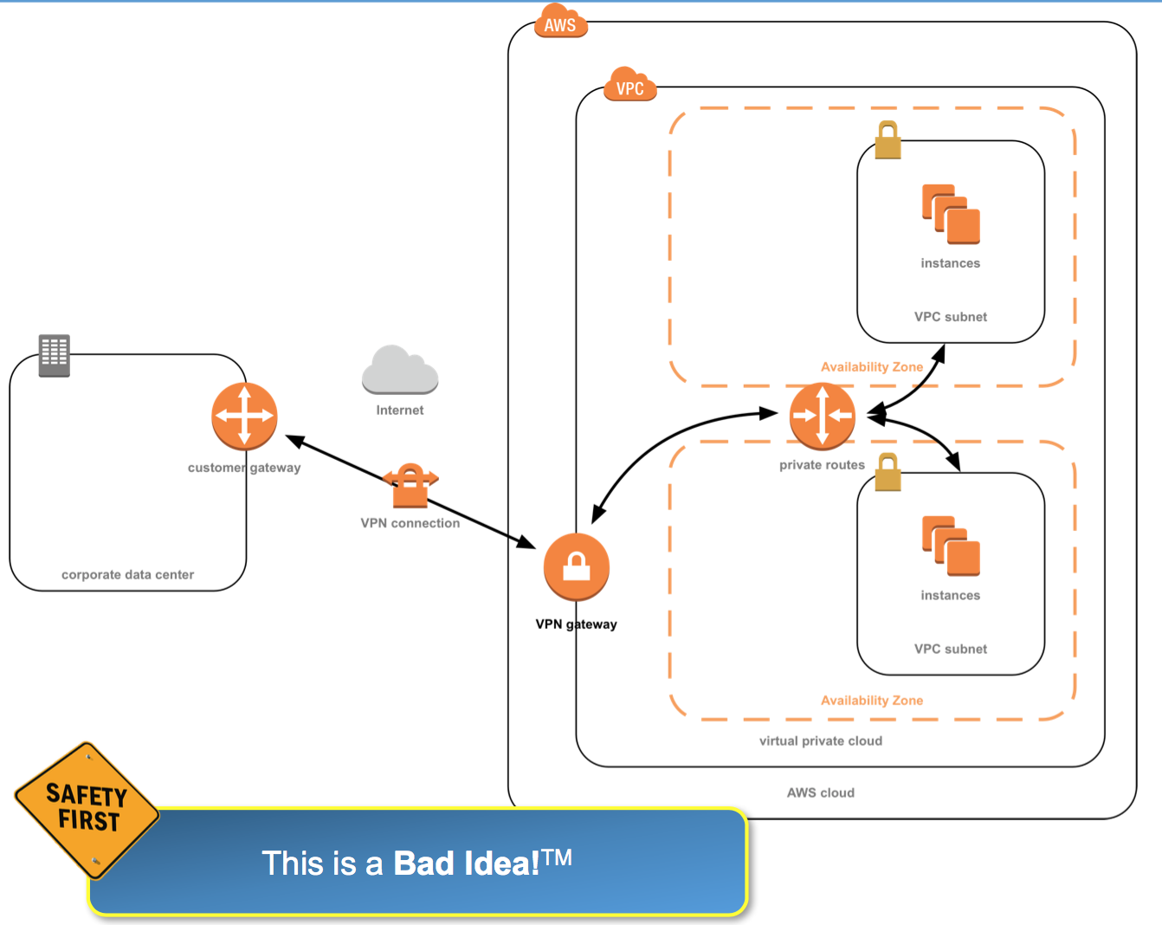
Migratory Patterns – Cloud on a Stick
Why this is bad: app has
dependencies back on-prem
(or on-prem has cloud
dependencies)

Slide 88
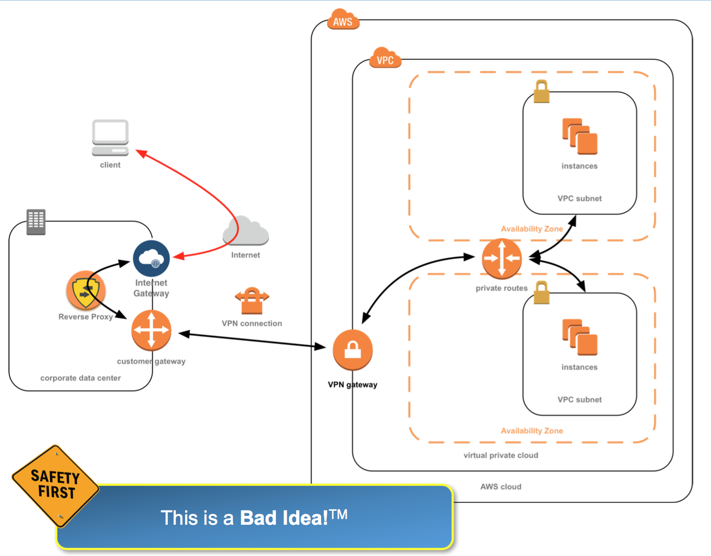
Cloud on a Stick with Backhaul

Slide 89
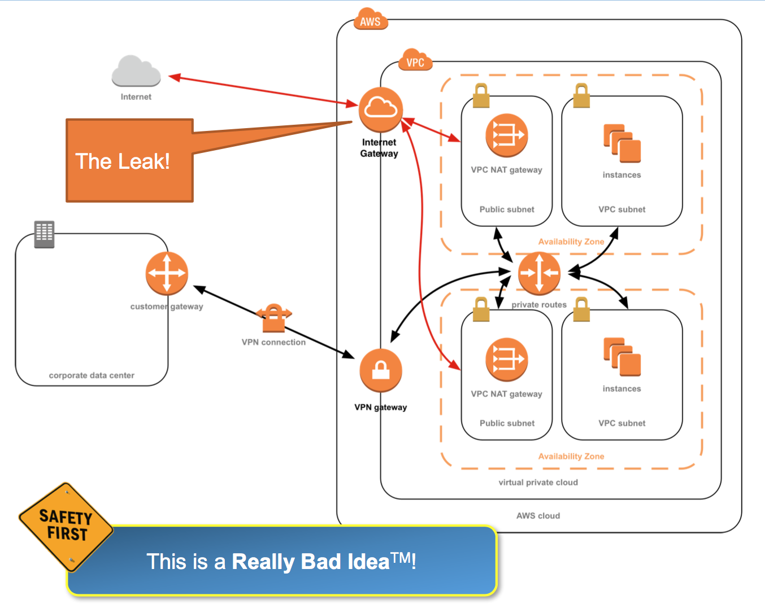
Leaky Cloud on a Stick

Slide 90
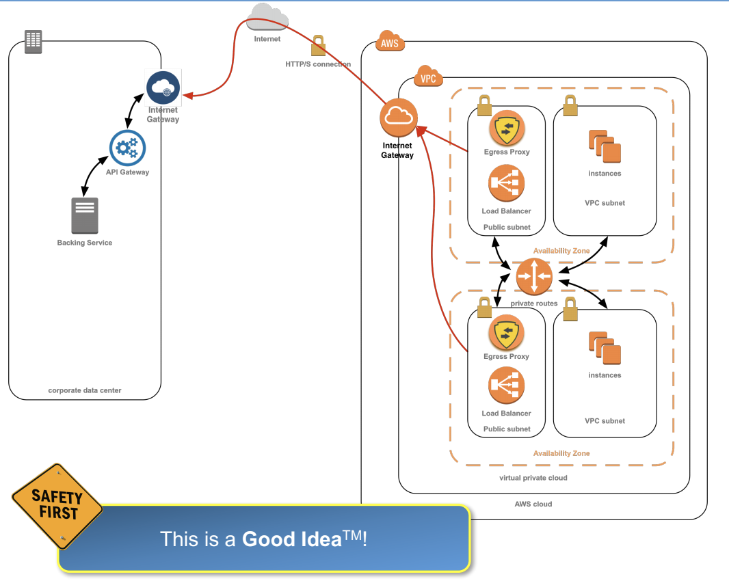
The better way…

Slide 91
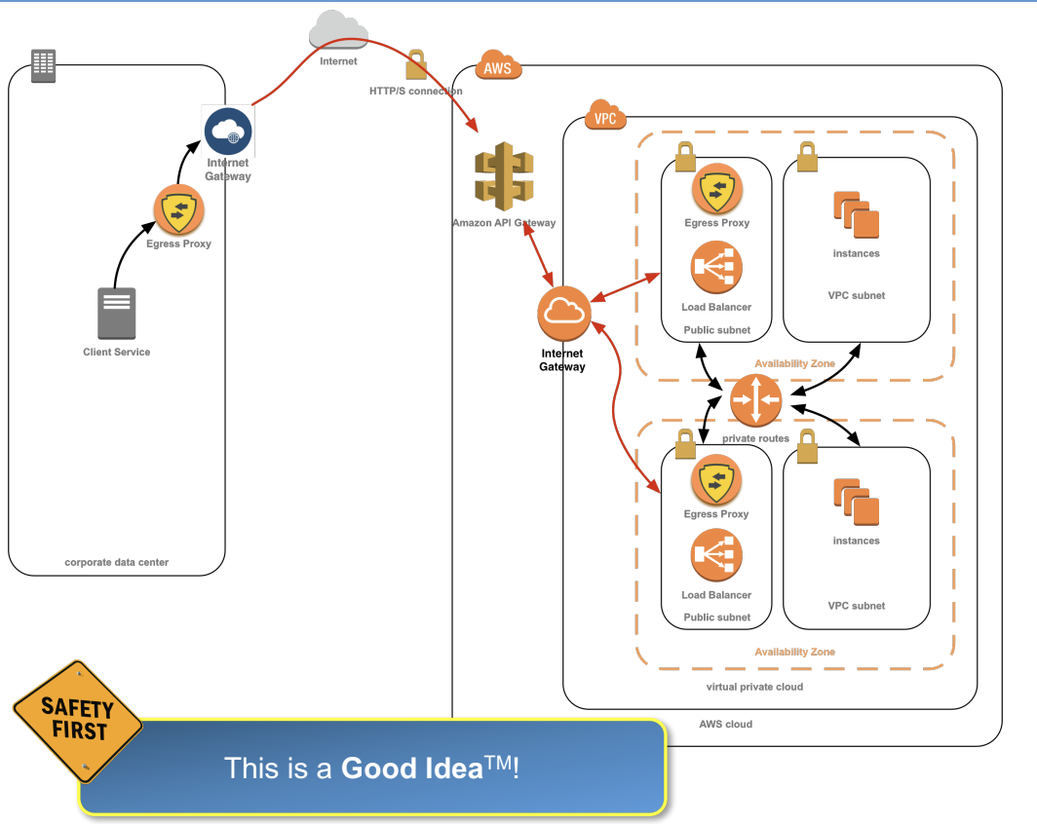
The better way…

Slide 92
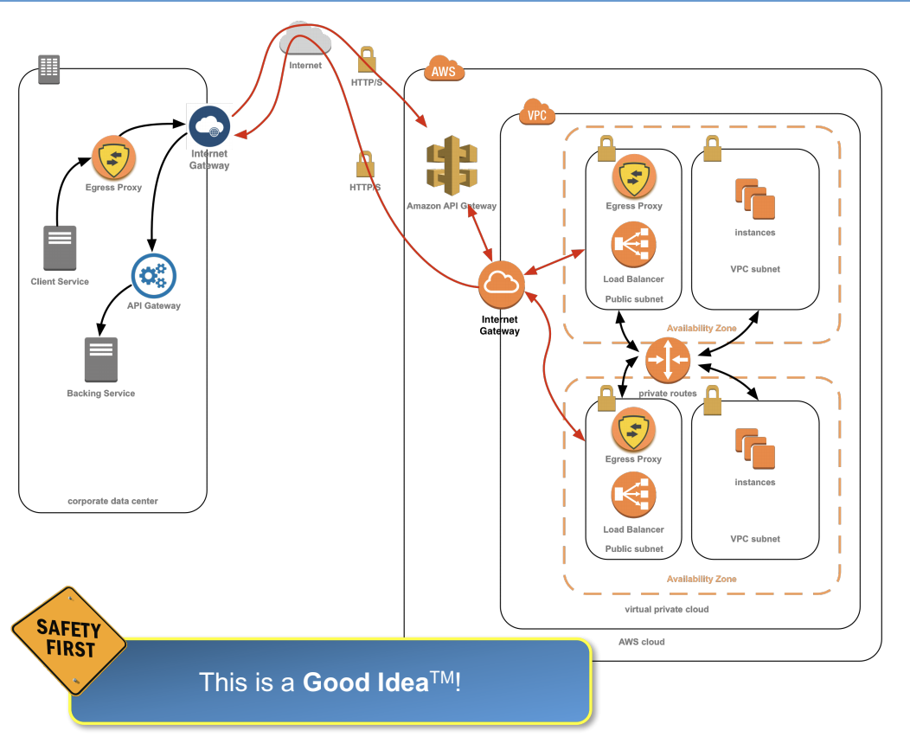
The better way…

Slide 93
More on these deployment methods
http://www.devsecops.org/presentations/
“This Old App” – Chris Wells and Christian Price, 2017 AppSecUSA

Slide 94
WAF: Web Application Firewall
Protect web apps by filtering out known attacks (SQLi, XSS, etc), bad IPs (from threat feeds), etc
Cloud-based options
Cloud provider (ex: AWS WAF)
3rd party hosted (ex: CloudFlare)
3rd party in cloud environment (ex: Imperva)

Slide 95
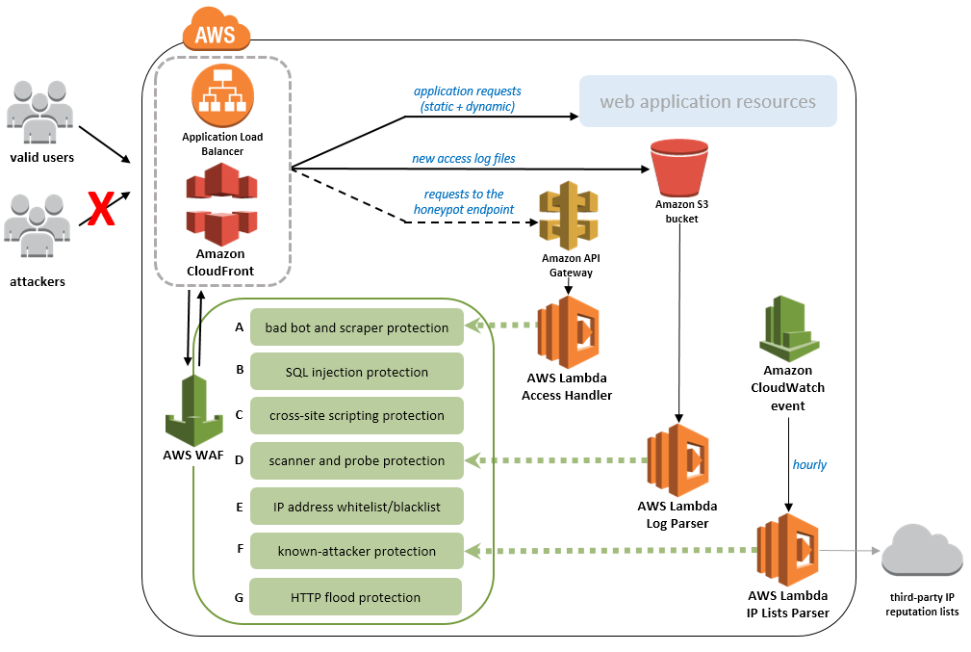

Slide 96
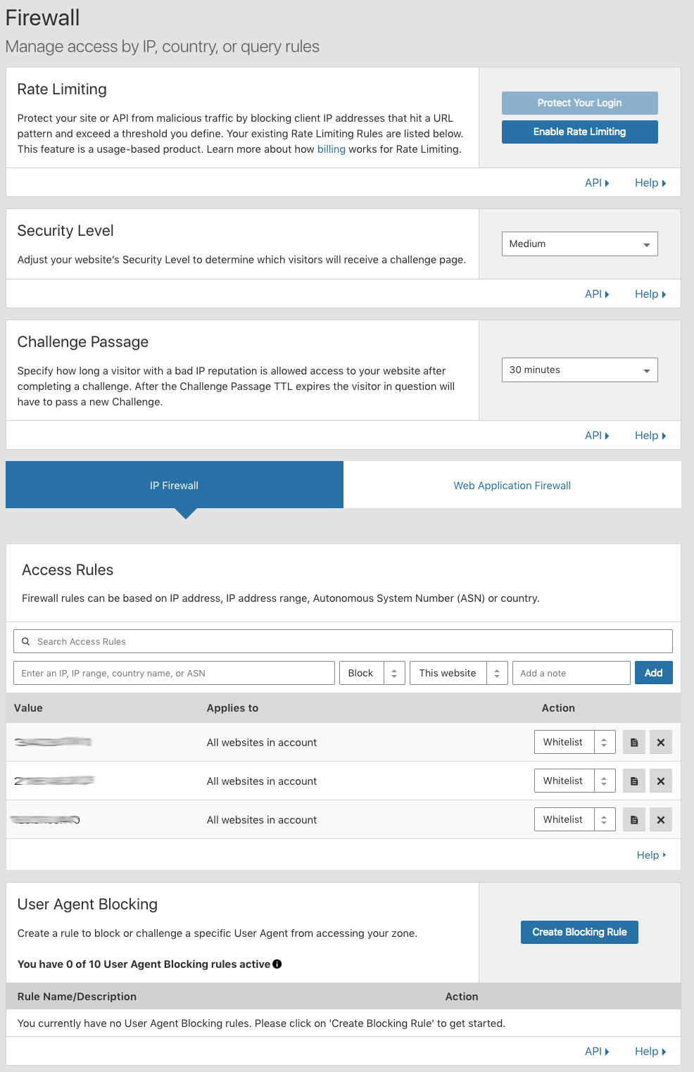
CloudFlare

Slide 97
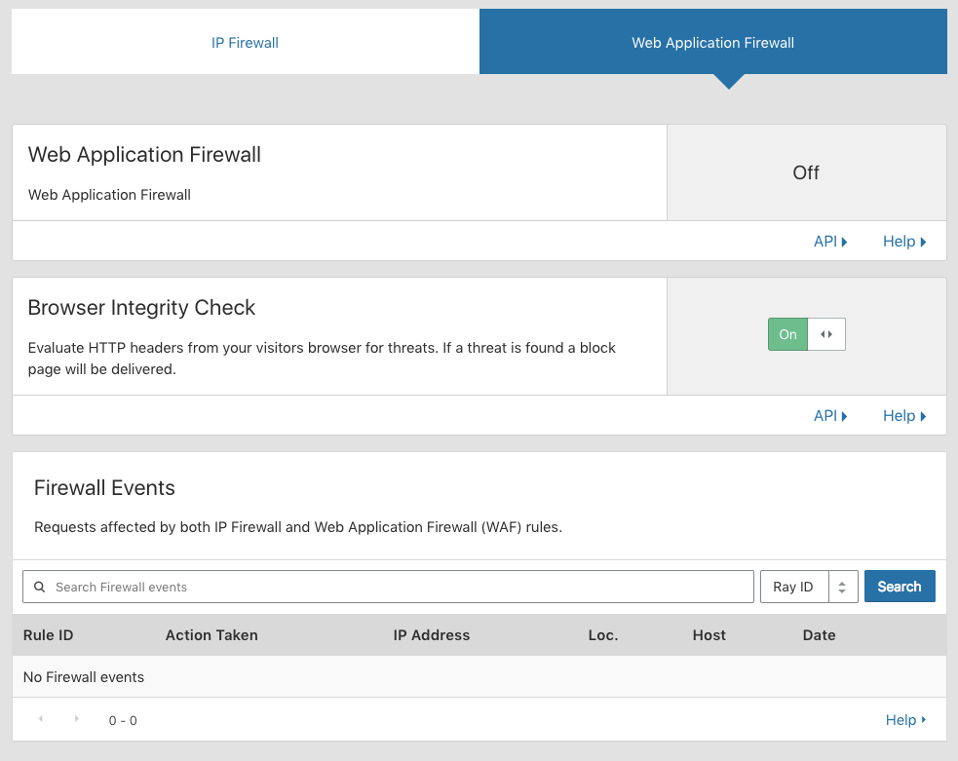
CloudFlare

Slide 98
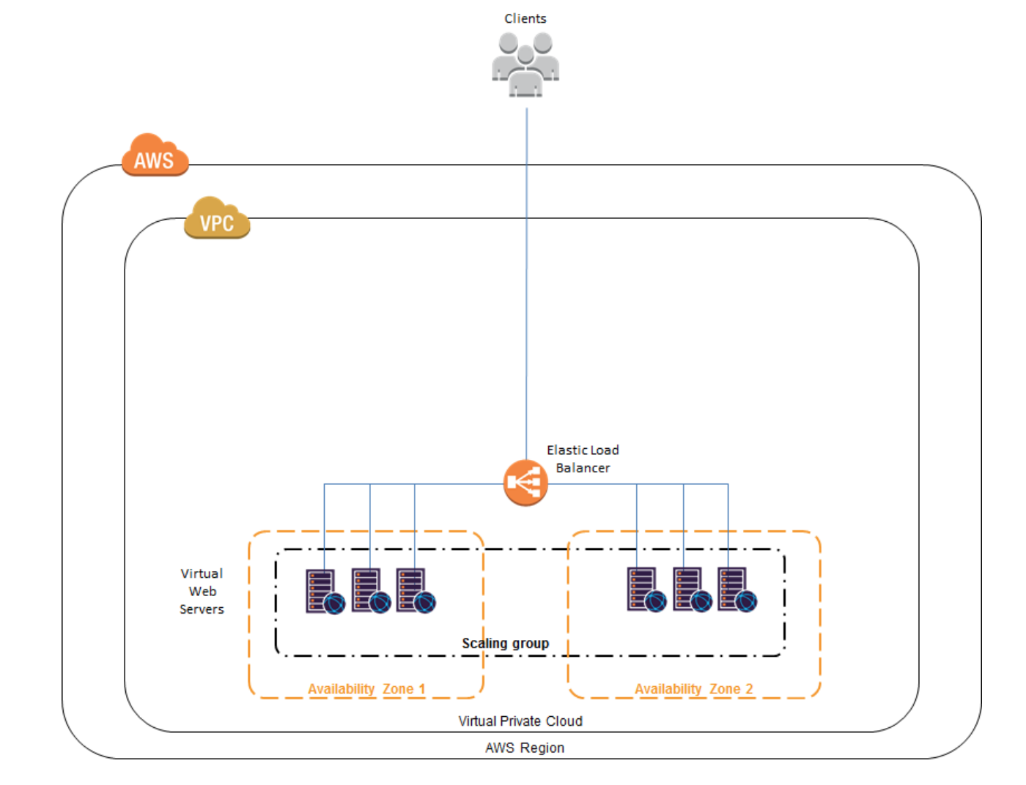
Ex: Imperva - Before
From: https://ftp-public.imperva.com/SecureSphere_Documentation/v13.0/Imperva-SecureSphere-v13.0-WAF-on-Amazon-AWS-On-Demand-Configuration-Guide.pdf

Slide 99
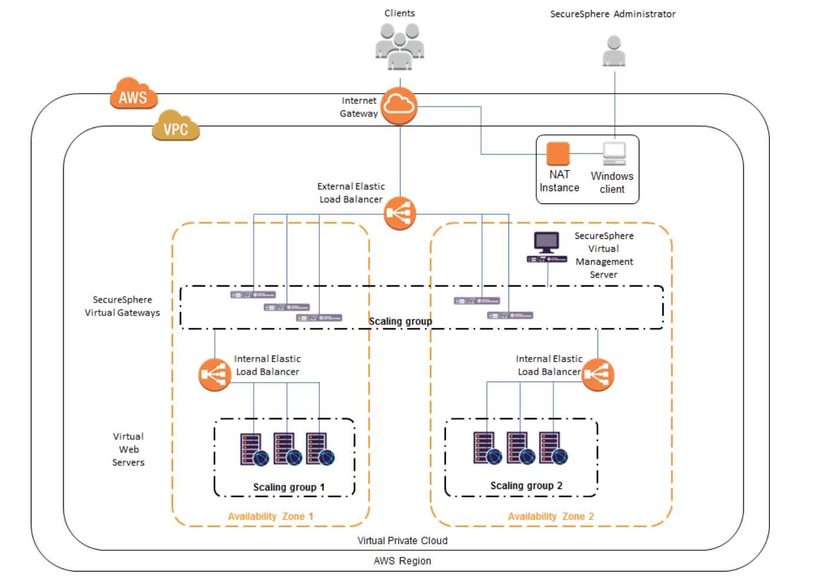
Ex: Imperva - After
From: https://ftp-public.imperva.com/SecureSphere_Documentation/v13.0/Imperva-SecureSphere-v13.0-WAF-on-Amazon-AWS-On-Demand-Configuration-Guide.pdf

Slide 100
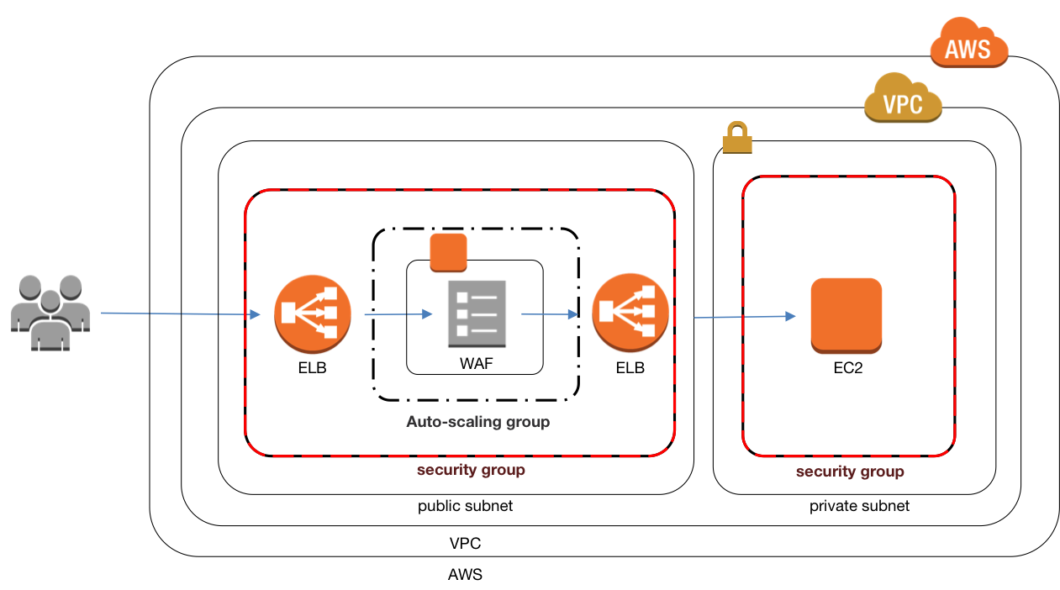
ELB Sandwich

Slide 101
ELB Sandwich
Make sure your logging on the end host is recording X-Forwarded-For to help log analysis.
You’re hacked and seeing all traffic (good and bad) coming from your ELB IP address = you’re going to have a bad time.

Slide 102
Database Firewall (Database Activity Monitoring)
Tool (SW or HW) that monitors database systems for unusual requests, high volume of requests, etc and then take action when issue detected (send alert, block connection, etc)
Why is someone running “SELECT *” … ?

Slide 103
API Gateway
Control API activity
Implement access control to API
API proxy to not directly expose API
Log API calls
Limit connections (DoS prevention)

Slide 104

Monolithic App

Slide 105
Monolithic App
You have a monolithic app and you need to move it to the cloud
It has clients and functions
Ex: Testudo (Schedule of classes, Add/Drop, Unofficial Transcript, etc.)

Slide 106
How do you eat an elephant?
One bite at a time…

Slide 107
Migrating a Monolith
Wrap the application in a RESTful web-service API
Add an adapter to isolate each client
Replace each one of those functions with a microservice
Wash, rinse, repeat

Slide 108
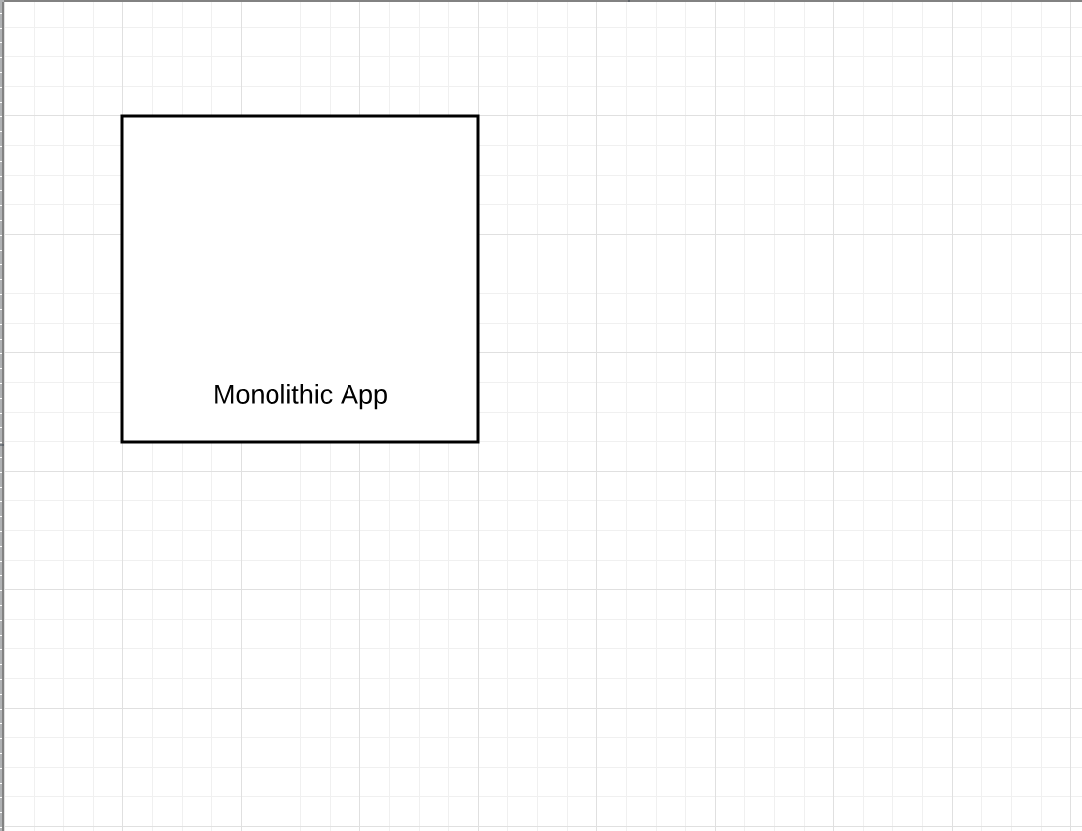
Monolithic App -> Microservices

Slide 109
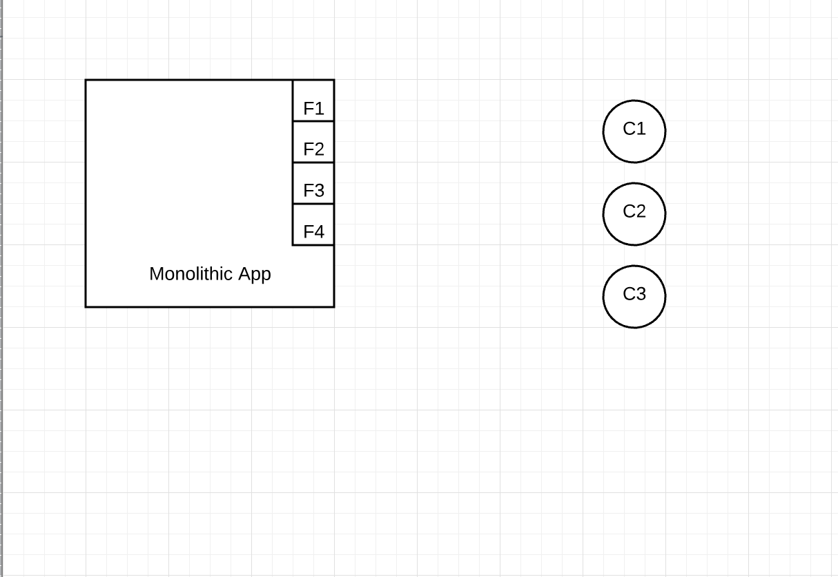
Monolithic App -> Microservices

Slide 110
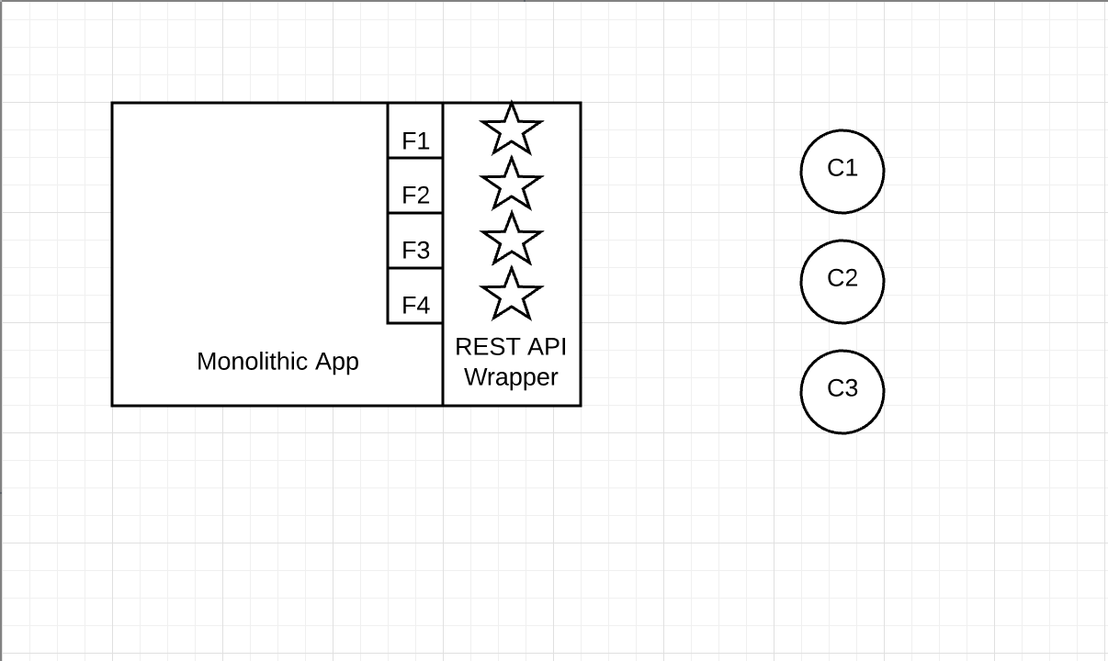
Monolithic App -> Microservices

Slide 111
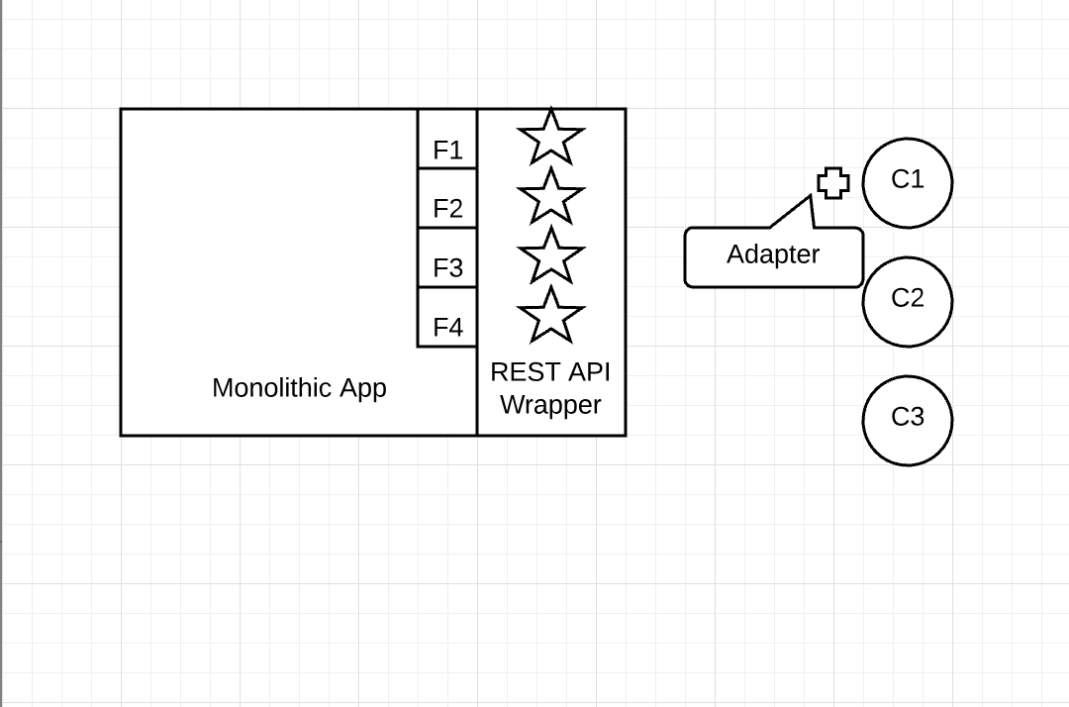
Monolithic App -> Microservices

Slide 112
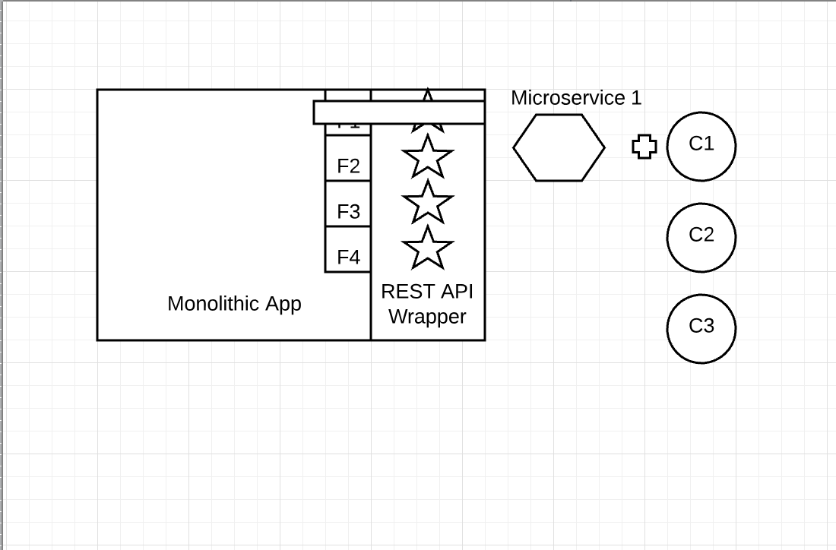
Monolithic App -> Microservices

Slide 113
Containers
With the rise of the cloud and DevOps containers have exploding in use
Ease of transporting across many different platforms
Entire runtime environment - app + dependencies + libraries + binaries + config files
Abstract away the OS and underlying infrastructure

Slide 114
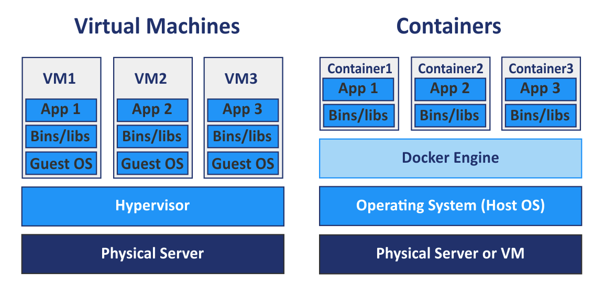
Containers vs VMs

Slide 115
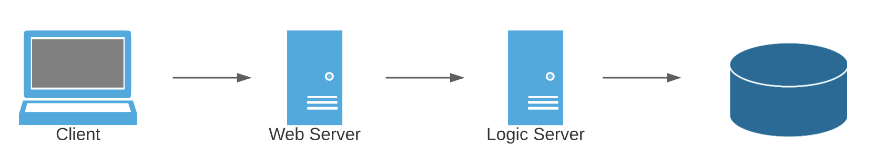
Standard 3 Tier app

Slide 116
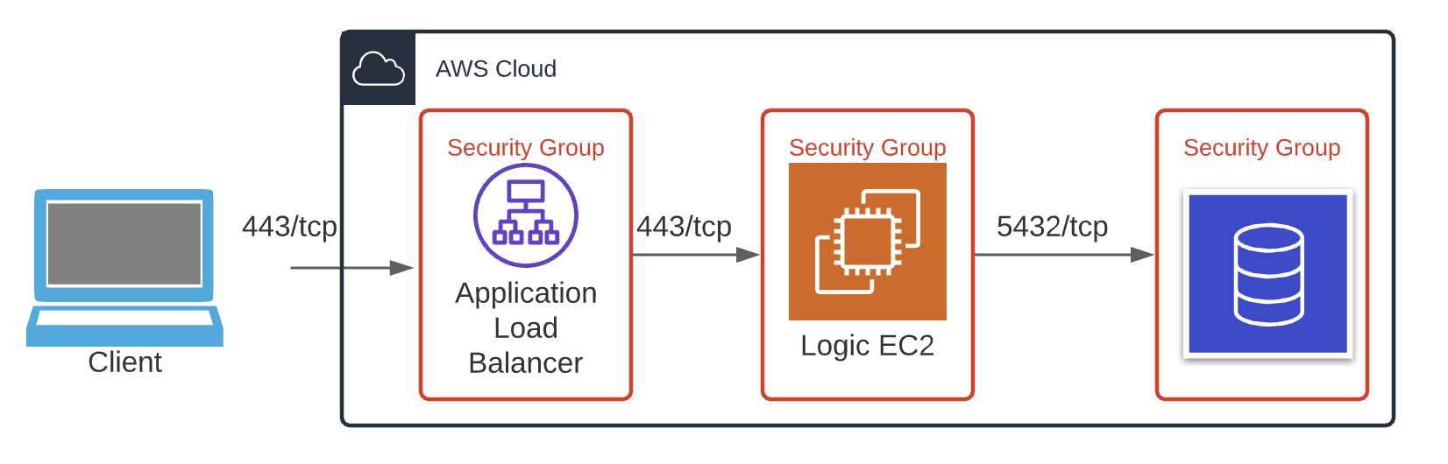
Standard 3 Tier app

Slide 117
But…
How do we get in to maintain/update this?

Slide 118
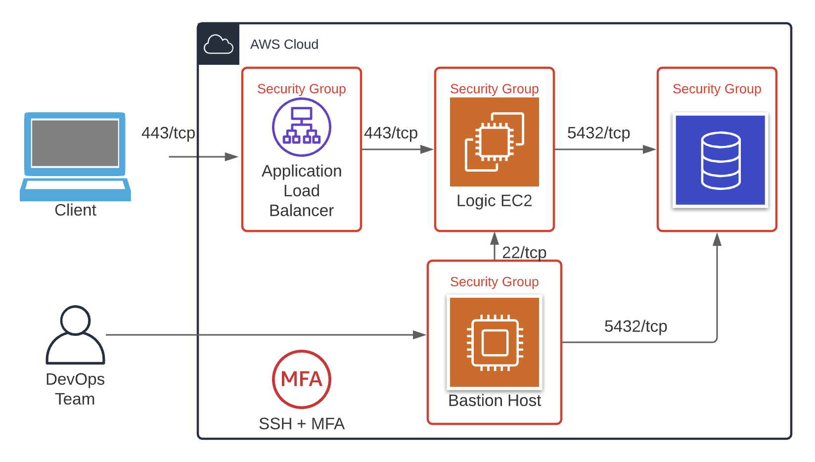
The side door…

Slide 119
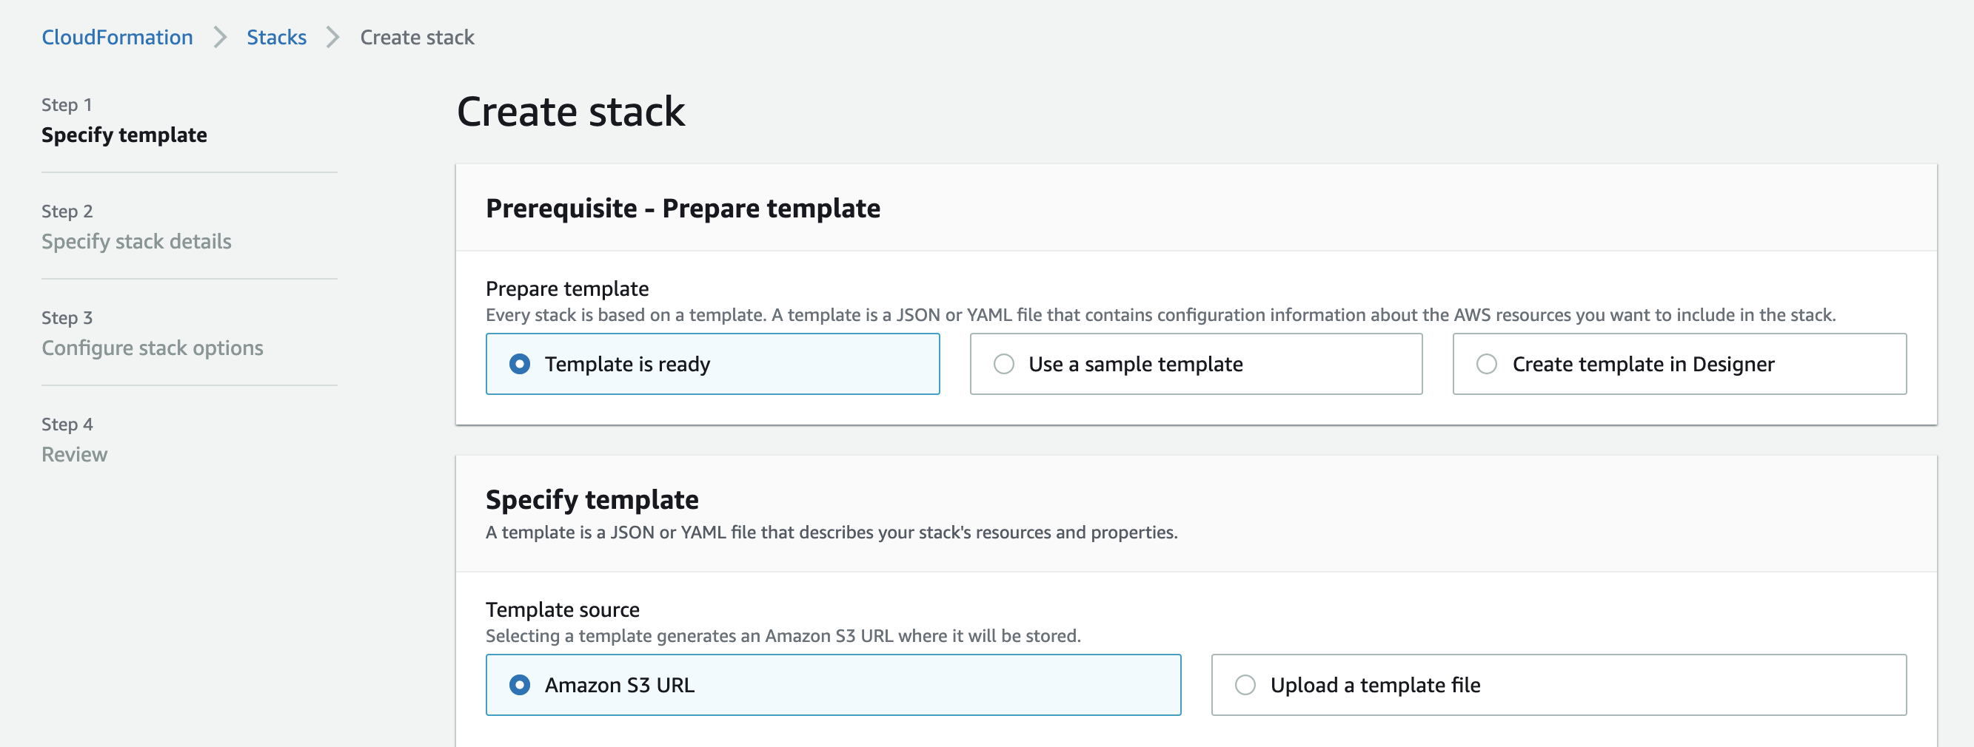
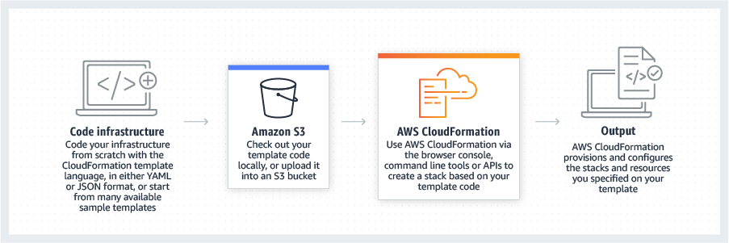
The even better way

Slide 120
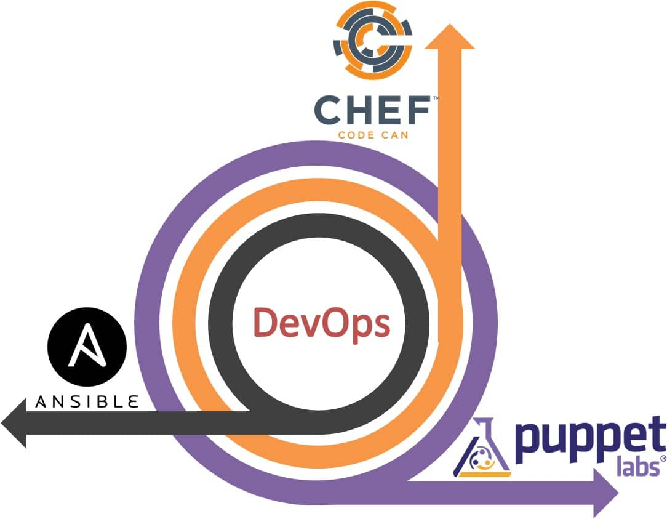
The even better way

Slide 121
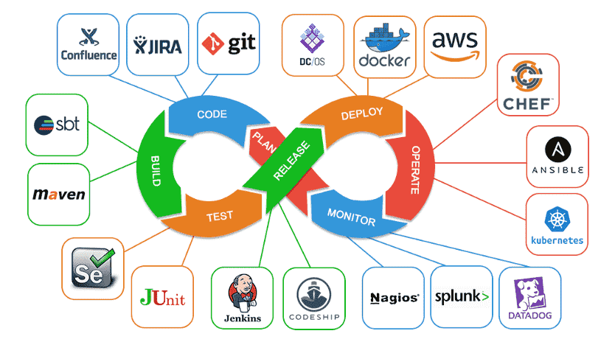
Everything is awesome…

Slide 122
The side door…

Slide 123
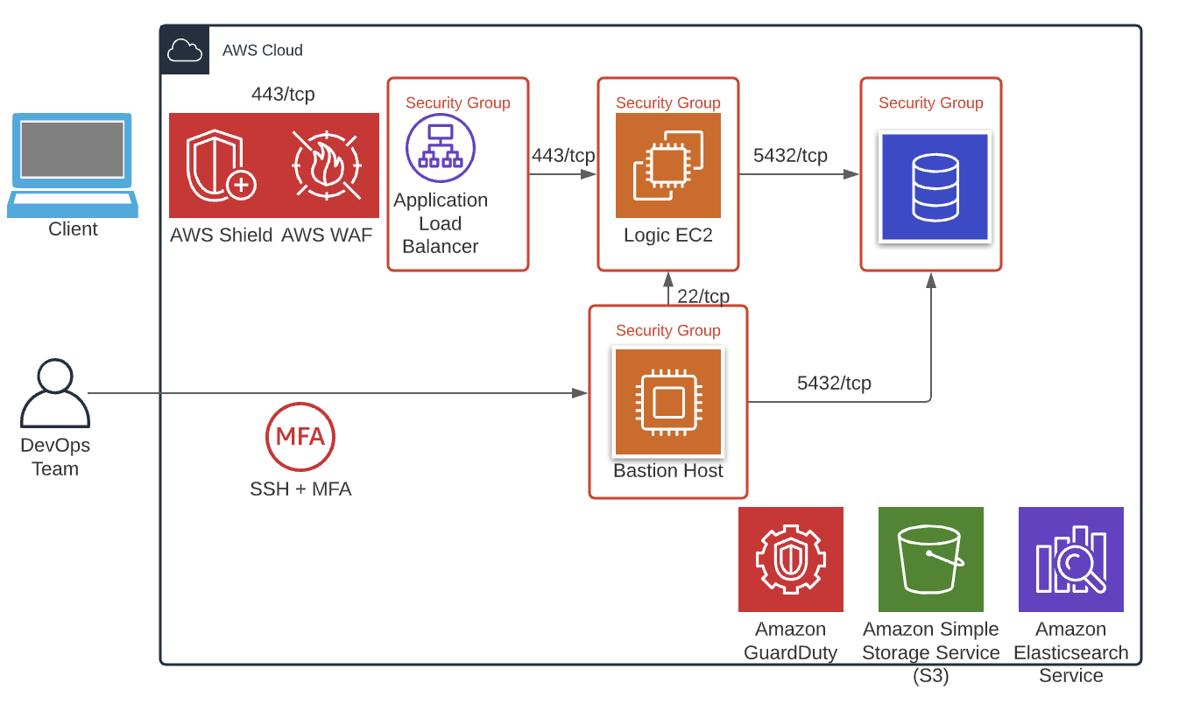
Turn on ALL the things!

Slide 124
Serverless Computing
You just write your code (that has something set to trigger it) and the cloud provider manages the instance for you.
No patching, management, etc. It all “just works!”
Ex: AWS Lambda, Azure Functions, Google Cloud Functions

Slide 125
Server vs Serverless
Bad code is still bad code
There is still a server lurking under there
SQL/command injection is still an issue
You can’t put IDS/IPS/Endpoint protection there

Slide 126
Server vs Serverless
Review your code
Check your permissions
Use an API Gateway
Protecting data/keys/secrets

Slide 127
Serverless Security Examples
https://github.com/alestic/lambdash
https://github.com/torque59/AWS-Vulnerable-Lambda
https://github.com/wickett/lambhack

Slide 128
More on Serverless
Gone in 60 milliseconds - https://media.ccc.de/v/33c3-7865-gone_in_60_milliseconds
Hacking Serverless Runtimes - https://www.blackhat.com/docs/us-17/wednesday/us-17-Krug-Hacking-Severless-Runtimes.pdf

Slide 129
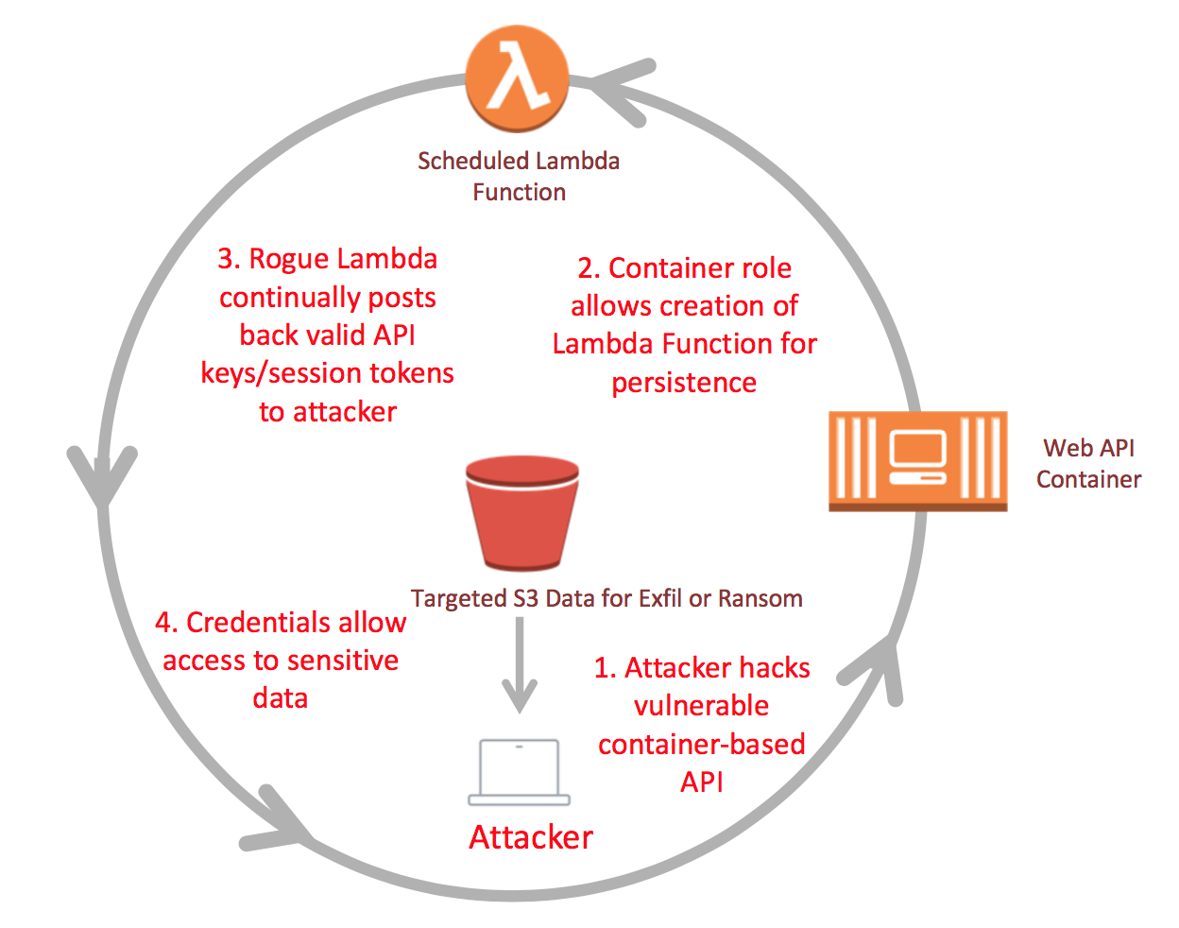
How could you detect this?

Slide 130
Chaos Monkey
https://github.com/Netflix/chaosmonkey
Developed by Netflix to randomly terminate instances to test resiliency.
Also has the security benefit of it someone gets in their access most likely won’t last for long.

Slide 131
Optional CCSP Study Reading
Chapter 7 – Cloud Application Security

